Slide 1

An investigation into occupational burnout among radiographers in Ireland due to the COVID-19 pandemic and the strategies used to cope with it"
Roisin Brennan and Dr Michaela Davis:
What is occupational burnout?
COVID-19 has had a significant impact on occupational burnout among radiographers in Ireland
3 aims of the study

Slide 2
Method
An anonymous survey was devised on SurveyMonkey
Six sections
Open and closed-ended questions
A pilot study was issued to all radiographers in a chosen radiology department and two University Academics
240 radiographers were selected for the main study using cluster sampling
A participant information leaflet was sent to all invitees
To provide further information - To Comply with Ethical Principles, Ethical Approval UTMREC- SM-UG-20-12-Brennan-Davis.
(Schoonenboom and Johnson, 2017)
(Thyer, 2009)
(Cohen, Manion and Morrison, 2018)
(Martinez-Mesa et al, 2016)
(Corti, 2019)
(Anabo, Elexpuru-Albizuri and Villardón-Gallago, 2018)

Slide 3
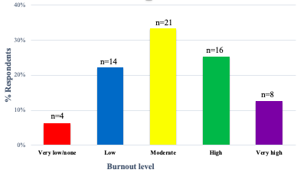
Findings
Key Points
Response rate: 40%
The data was interpreted using statistical
(quantitative) and thematic (qualitative) analysis.
COVID-19 was one of the leading causes of reported burnout:
Fear of contracting the virus and transmitting it to family/friends/housemates
Psychological distress from imaging infected patients
Colleagues who do not obey guidelines
Working hours - On- call
Various coping mechanisms both in and outside of work were alluded to:
Infection control - Conflict resolution - Requesting assistance - Time off
Talking to others - Hobbies - Relaxing - Managerial changes
Figure 1. Levels of occupational burnout experienced by respondents
(Blann, 2015)
(Hilal and Alabri, 2013)

Slide 4
Conclusion
Radiographers in Ireland are experiencing high levels of occupational burnout:
48% reported suffering from moderate to very high burnout
No relationship between burnout and participant demographics was identified
The findings of the research could aid further research into improving workplace factors contributing to burnout- both during and after the pandemic
Statistically significant coping mechanisms included:
Infection control - Relaxing when it is quiet - Conversing with colleagues
Acquiring enough sleep - Planning time for friends and family
Leaving work behind at the end of the day - Isolating to minimise COVID-19 transmission risk

Slide 5
Implications For Practice
Elevated occupational burnout among radiographers can result in:
Reduced quality of care and risks of patient safety impairments:
Studies have found that there are strong statistical relationships between these and high levels of occupational burnout (Salyers et al, 2016).
Deteriorated physical and mental health of radiographers (Salvagioni et al, 2017; Zhang et al, 2020).
It is crucial that emphasis is placed on giving radiographers the help and support that they require as we exit from the pandemic.
(Makary and Daniel, 2016)
(Matsuo et al, 2020)

Slide 6
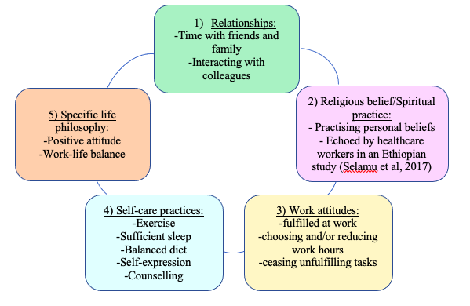
Implications For Practice
Figure 1. Five-point occupational burnout coping strategy (De Hert, 2020)
What Can Radiographers Change?
The management mechanisms identified could be of benefit in the future to radiographers and other researchers alike
Obeying guidelines and practising infection control was widely reported, similar to other research (Foley, O’Loughlin and Creedon, 2020).
The findings share multiple similarities with a 5-point burnout coping strategy devised by De Hert (2020) as depicted in Figure 1.

Slide 7
Implications For Practice
What Can Radiographers Change?
Techniques that could be implemented by radiographers into their daily lives based on the results of the study include:
Resolving conflict peacefully
Talking to family and friends
Ensuring a work-life balance
Exercising
Relaxing
Acquiring enough sleep
Taking time off
Practicing mindfulness
Availing of a support system (counselling, support groups, etc.)
(De Hert, 2020)
(Montgomery et al, 2019)
(Cheng et al, 2020)
(McFadden, 2015)
(Firoozabadi, Uitdewilligen and Zijlstra, 2018)
(Kay et al, 2008)
(Conti et al, 2020)
(O’Connor et al, 2020)

Slide 8
References
Anabo, I.F, Elexpuru-Albizuri, I, and Villardón-Gallego, L. (2019) ‘Revisiting the Belmont Report’s ethical principles in internet-mediated research: perspectives from disciplinary associations in the social sciences’, Ethics and Information Technology, 21(2), pp.141-147.
Blann, A. (2015) Data Handling And Analysis. 1st edn. Oxford: Oxford University Press, p.112.
Chor, W.P.D. Ng, W.M. Cheng, L. Situ, W. Chong, J.W. Ng, L.Y.A. Mok, P.L. Yau, Y.W. and Lin, Z. (2020) ‘Burnout amongst emergency healthcare workers during the COVID-19 pandemic: A multi-center study’, The American Journal of Emergency Medicine, pp.1-3. Available at: https://www.ajemjournal.com/article/S0735-6757(20)30936-0/fulltext#articleInformation (Accessed on 11th February 2021).
Cohen, L. Manion, L. and Morrison, K. (2018) Research methods in education, 8th edn. New York: Routledge, pp. 212, 246, 275-280. Available at: https://ebookcentral.proquest.com/lib/ucd/reader.action?docID=5103697 (Accessed on 27 November 2020).
Conti, C. Fontanesi, L. Lanzara, R. Rosa, I. and Porcelli, P. (2020) ‘Fragile heroes. The psychological impact of the COVID-19 pandemic on health-care workers in Italy’, PloS one, 15(11), pp.e0242538.
Corti, L. Van den Eynden, V. Bishop, L. and Woollard, M. (2019) Managing and sharing research data: a guide to good practice. 2nd edn. London: SAGE Publications Limited, pp.179.

Slide 9
References
De Hert, S. (2020) ‘Burnout in Healthcare Workers: Prevalence, Impact and Preventative Strategies’, Local and Regional Anesthesia, 13, pp.171.
Firoozabadi, A. Uitdewilligen, S. and Zijlstra, F.R. (2018) ‘Should you switch off or stay engaged? The consequences of thinking about work on the trajectory of psychological well-being over time’, Journal of Occupational Health Psychology, 23(2), p.278.
Foley, S.J. O’Loughlin, A. and Creedon, J. (2020) ‘Early experiences of radiographers in Ireland during the COVID-19 crisis’, Insights into Imaging, 11(1), pp.1-8.
Hilal, A.H. and Alabri, S.S. (2013) ‘Using NVivo for data analysis in qualitative research’, International interdisciplinary journal of education, 2(2), pp.181-186.
Makary, M.A. and Daniel, M. (2016) ‘Medical error—the third leading cause of death in the US’, Bmj, 353, pp.1-5.
Martínez-Mesa, J. González-Chica, D.A. Duquia, R.P. Bonamigo, R.R. and Bastos, J.L. (2016) ‘Sampling: how to select participants in my research study?’, Anais brasileiros de dermatologia, 91(3), pp.326-330.
Montgomery, A. Panagopoulou, E. Esmail, A. Richards, T. Maslach, C. (2019) ‘Burnout in healthcare: the case for organisational change’, Bmj, 366, pp.1-5.
Morse, G. Salyers, M.P. Rollins, A.L. Monroe-DeVita, M. and Pfahler, C. (2012) ‘Burnout in Mental Health Services: A Review of the Problem and its Remediation’, Adm Policy Ment Health, 39(5), pp. 341–352.

Slide 10
References
O’Connor, K. Wrigley, M. Jennings, R. Hill, M. and Niazi, A. (2020) ‘Mental health impacts of COVID-19 in Ireland and the need for a secondary care mental health service response’, Irish Journal of Psychological Medicine, pp.1-18.
Salvagioni, D.A.J. Melanda, F.N. Mesas, A.E. González, A.D. Gabani, F.L. and Andrade, S.M.D. (2017) ‘Physical, psychological and occupational consequences of job burnout: A systematic review of prospective studies’, PloS one, 12(10), p.e0185781.
Schoonenboom, J. and Johnson, R.B. (2017) ‘How to construct a mixed methods research design’, KZfSS Kölner Zeitschrift für Soziologie und Sozialpsychologie, 69(2), pp.107-131.
Thyer, B. (2009) The handbook of social work research methods. 2nd edn. California: Sage Publications, pp. 232-233.

Slide 11

Thank You
Any Questions:
Contact details
Róisín Brennan: roisin.brennan2@ucdconnect.ie
Dr Michaela Davis: michaela.davis@ucd.ie

