Slide 1



USE OF GAMMA RADIATION FOR THE CHARACTERIZATION OF BIOFORTIFIED TOMATO PLANTS INTENDED FOR SPACE CULTIVATION
Riccardo Pagliarello^{1°,2}, Ilaria Di Sarcina^{1#}, Elisabetta Bennici^{1°}, Giuseppe Ferrara^{1#}, Luca Nardi^{1°}, Eugenio Benvenuto^{1°}, Alessia Cemmi^{1#}, Silvia Massa^{1°}*
1 ENEA, Italian National Agency for New Technologies, Energy and Sustainable Economic Development.
2 University of Tuscia, DAFNE – Department of Agriculture and Forest Sciences, Viterbo, Italy.
° Biotechnology and Agro-Industry Division, Casaccia Research Center. Rome, Italy.
# Fusion and Nuclear Safety Technologies Department, FSN-FISS-SNI, Casaccia Research Center. Rome, Italy
* Corresponding author, e-mail: silvia.massa@enea.it

Slide 2

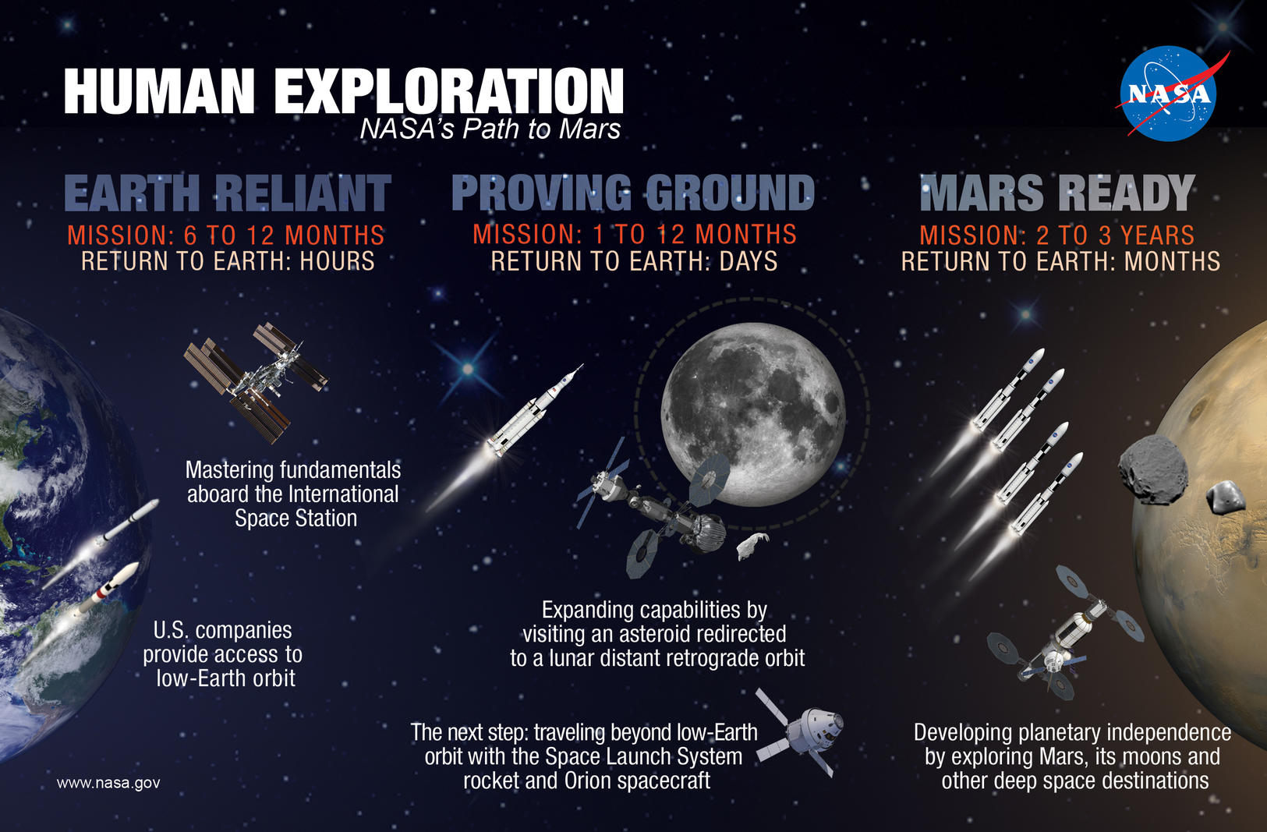


Slide 3
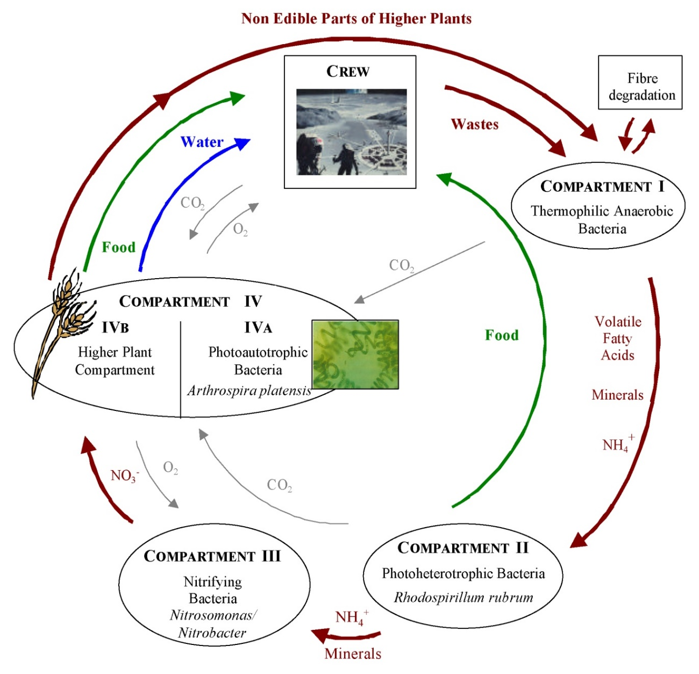

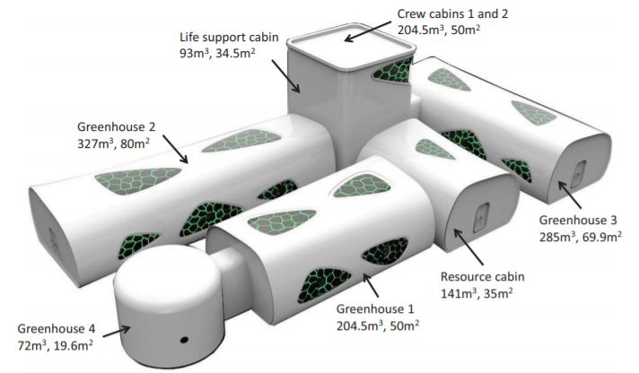

Cultivation of plants in long-term human stay in space
Controlled Ecological Life Support System (CELSS) ©Yuan et al., 2019
A principal flow diagram of a closed bio-regenerative life support system in space technology ©Melissa Foundation

Slide 4
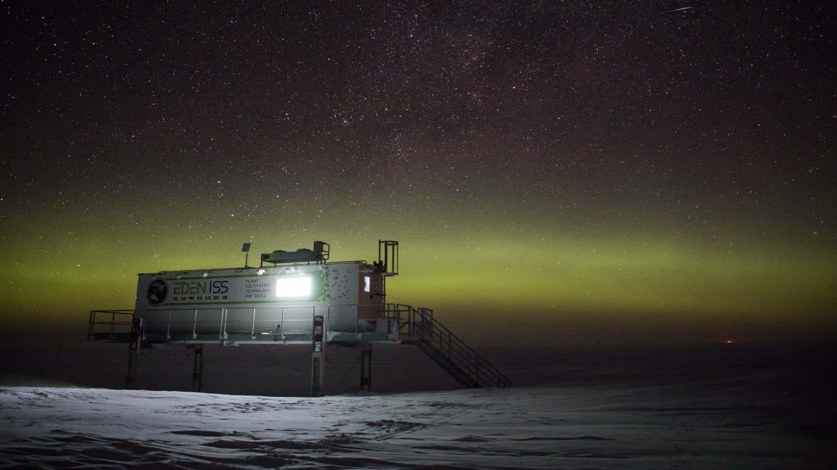

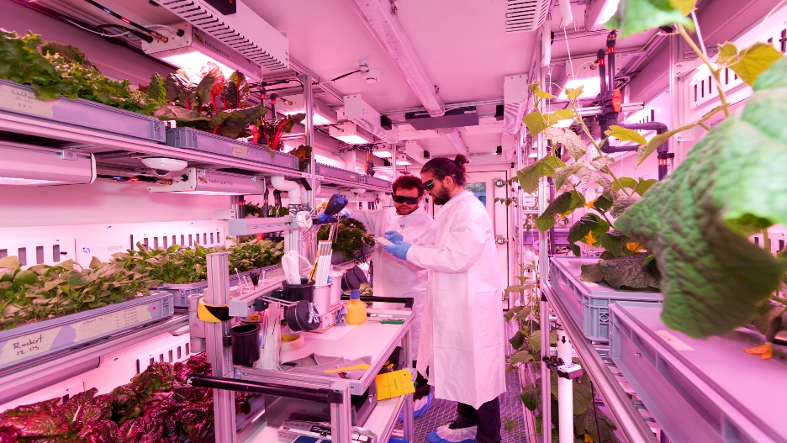
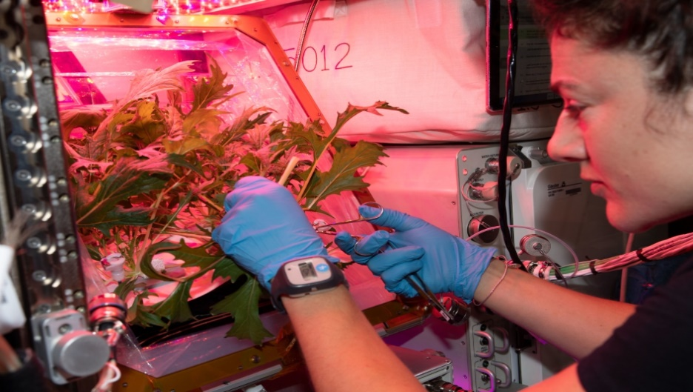
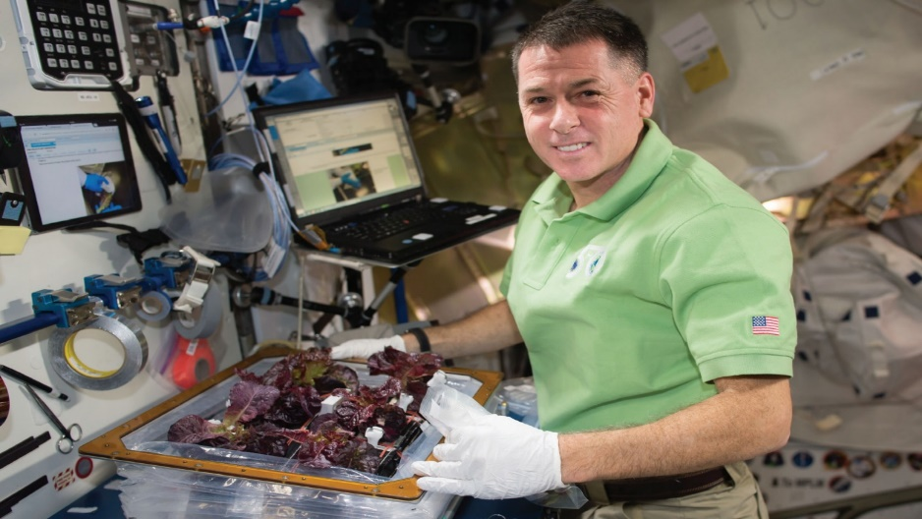

Cultivating crops in a confined environment
EDEN-ISS module ©Mullet, AWI
Inside of the EDEN-ISS module ©Stubenrauch, SATC
NASA astronaut Jessica Meir cuts Mizuna mustard green leaves grown on the International Space Station for the VEG-04B space agriculture study, ©NASA
Astronaut Shane Kimbrough in front of the 'Veggie' chamber on the ISS, ©NASA

Slide 5
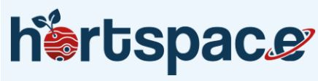


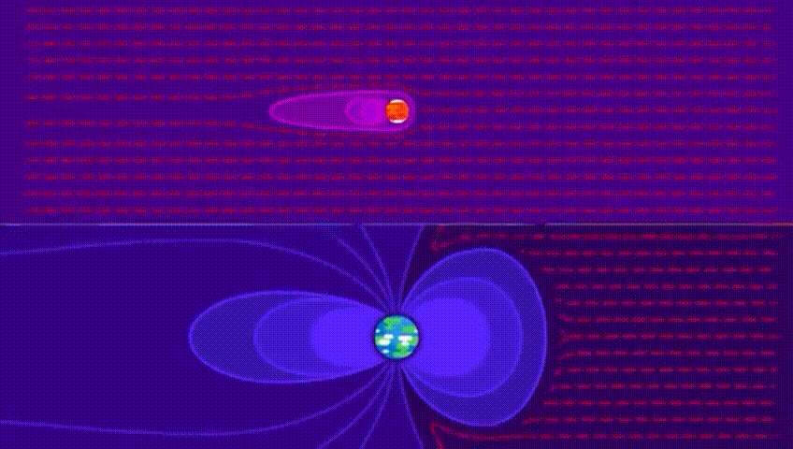
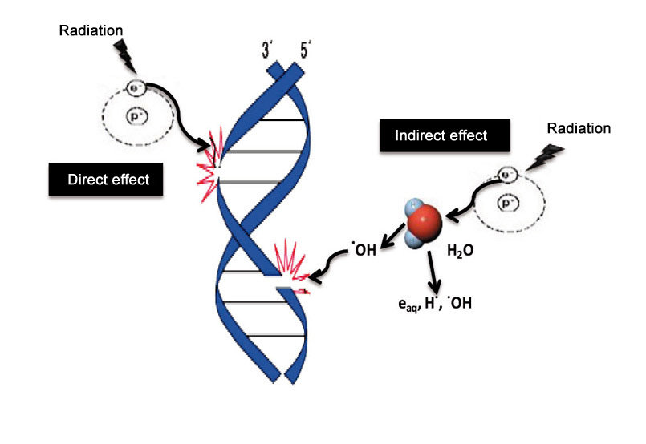
Cultivation of plants in extreme environments
Permanent ionizing radiation (IR) on Mars Surface
©Kurzgesagt – In a Nutshell
©Kurzgesagt – In a Nutshell
Cultivation of plants as a source of:
fresh food
bioactive molecules are able to counteract the effects of permanence in confined environments exposed to astro-physical stimuli
Pathological conditions:
Cancer
Immune depression
Neudegenerative diseases
Inflammatory diseases
Ageing

Slide 6
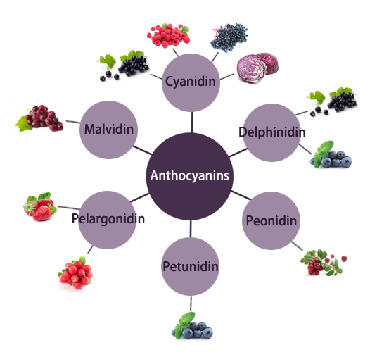
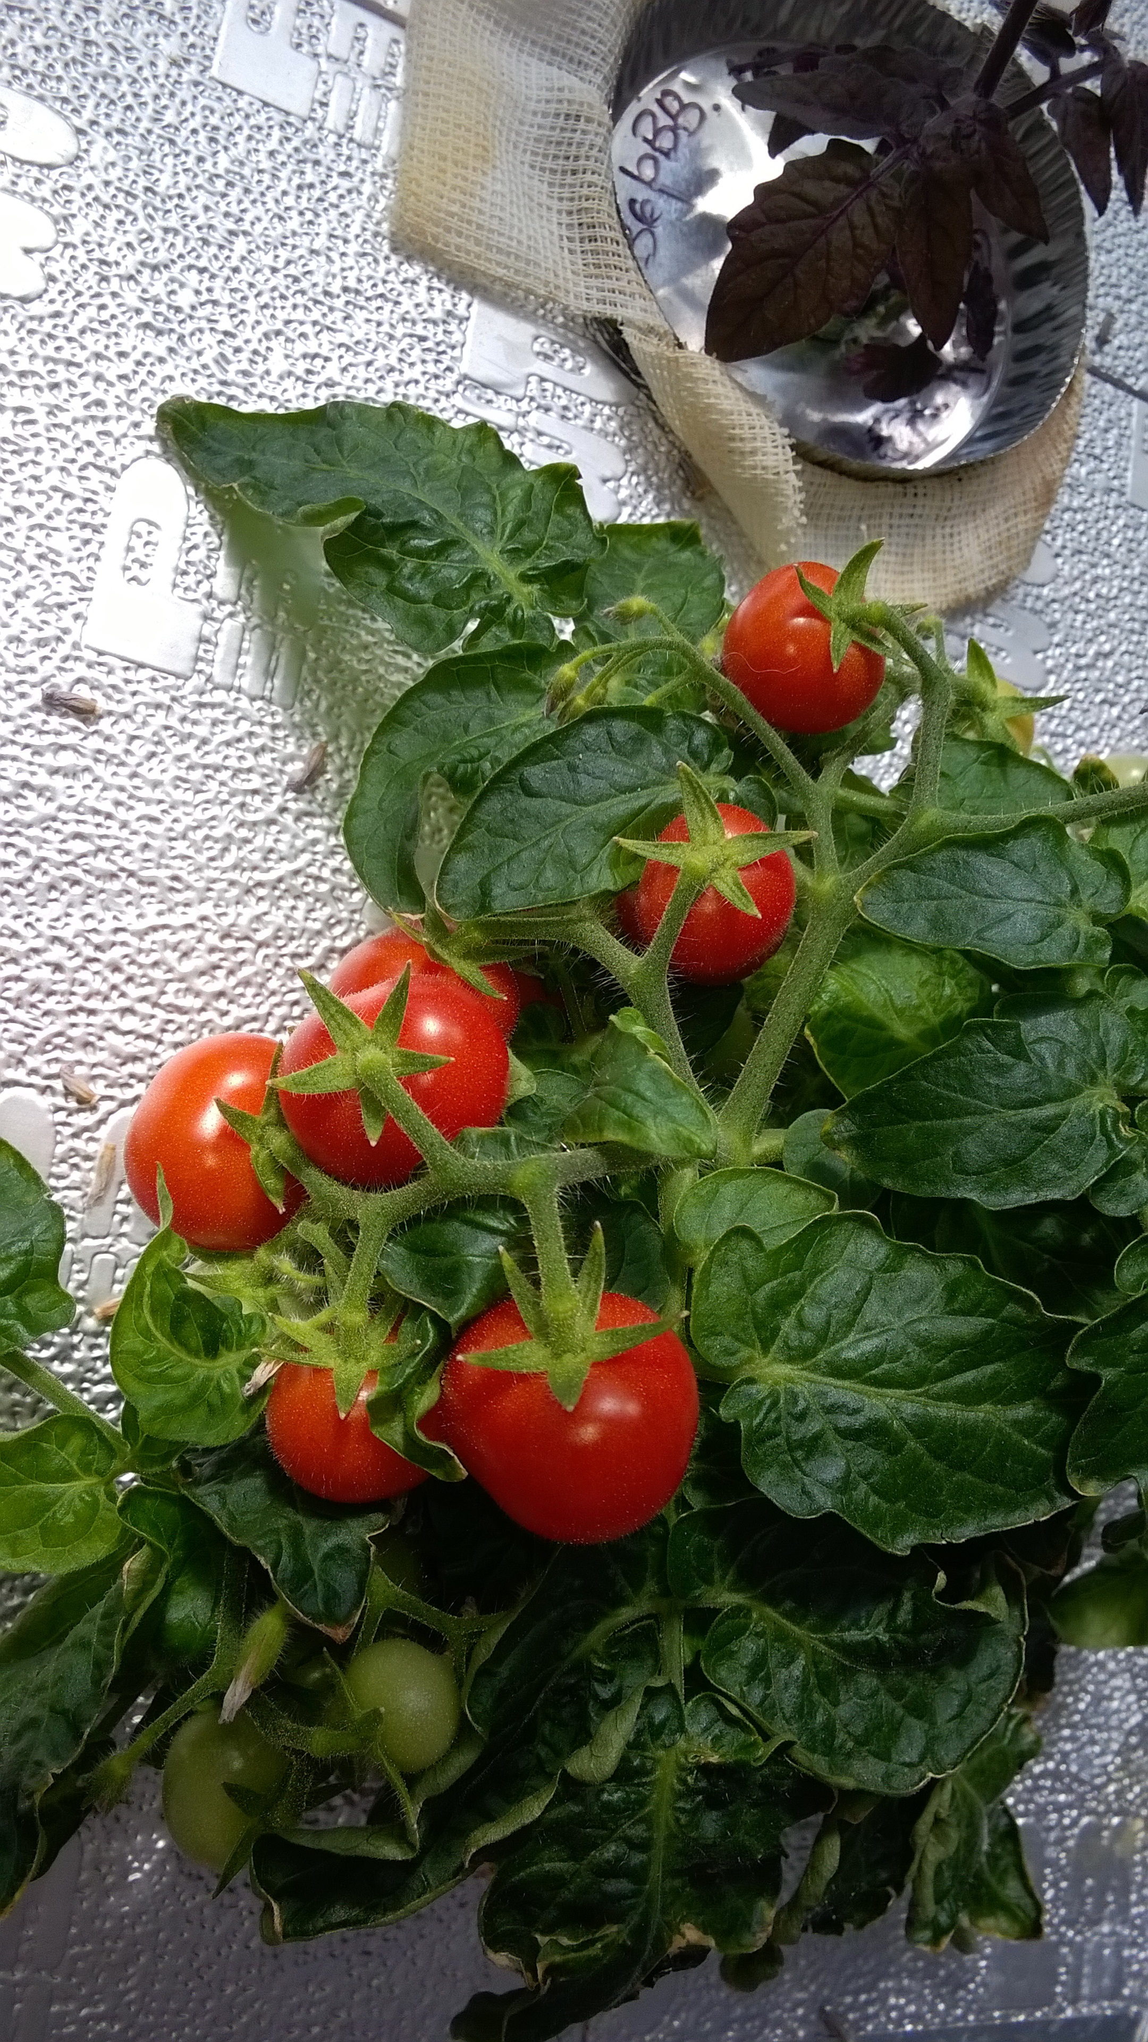
Optimization of the production of natural anti-oxidants in plants
Fourth most popular fresh-market vegetable behind potatoes, lettuce and onions
Source of bioactive molecules with beneficial effects on health, due to the abundance of: alpha-lipoic acid, lycopene, choline, folic acid, beta-carotene, lutein, ascorbic acid.
Nutraceutical role
protect plants against oxidative stress
(i.e. due to ionizing radiation), softening, rotting, fungal infections
Solanum lycopersicum L., cv. MicroTom was bioengineered for anthocyanins accumulation, using the R2R3-MYB from Petunia hybrida at the Department of Plant Development and (Epi)Genetics, Swammerdam Institute for Life Sciences, University of Amsterdam.
Two lines expressing two different levels of anthocyanins bioaccumulation were obtained: the Intermediate anthocyanins genotype (IAG) and the high anthocyanins genotype (HAG).

Slide 7
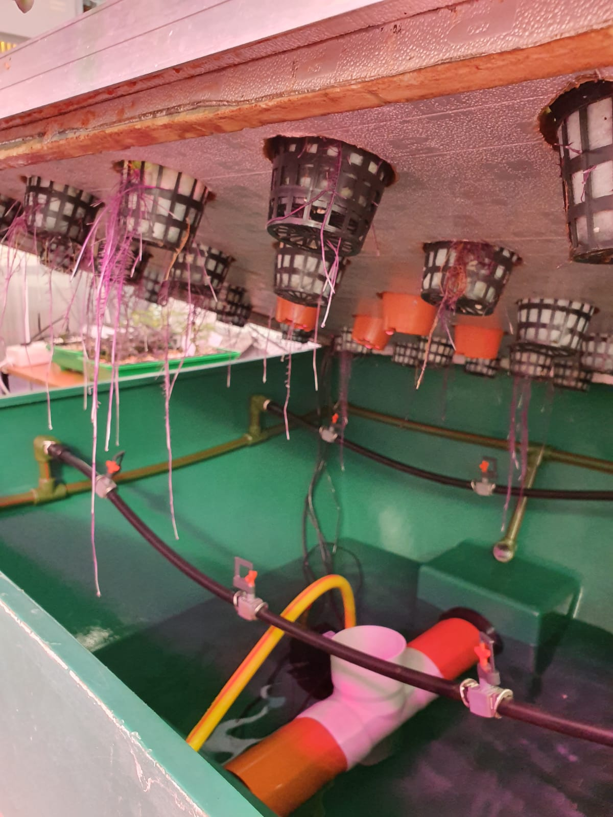
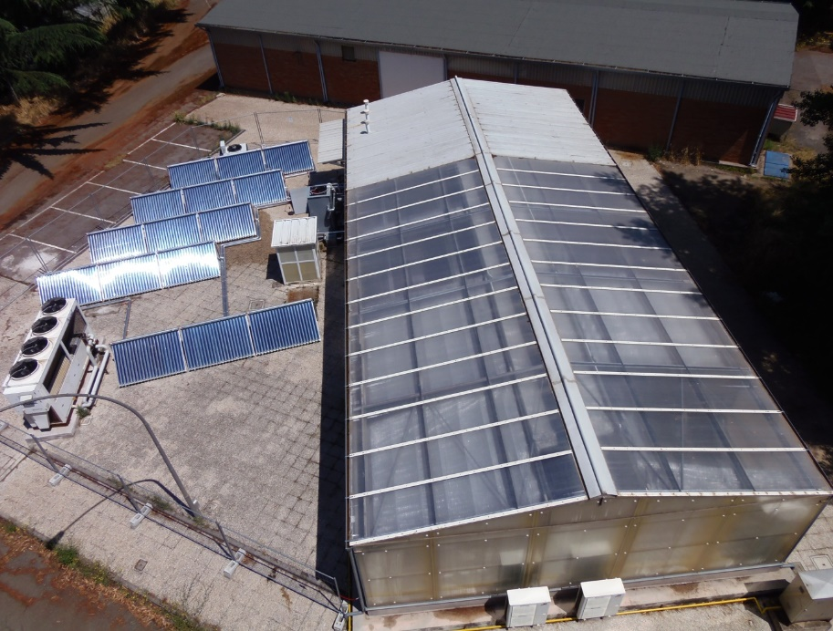
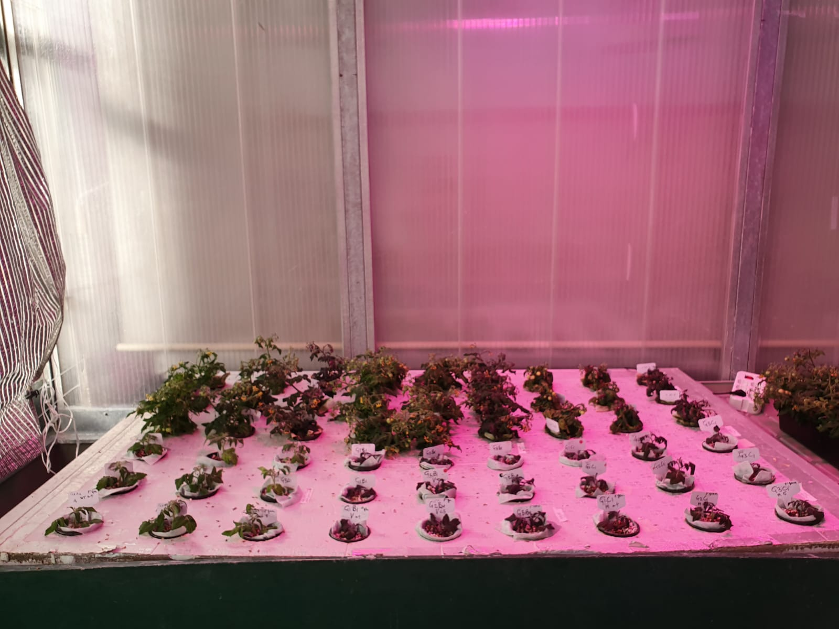
Materials and growth conditions
Plant material: S. lycopersicum L., cv. ‘MicroTom’ (wild type, IAG and HAG lines);
Plants were cultivated in a containment greenhouse on an hydroponic system, integrating natural light with artificial light (blue LED 70 µmol⁻² sec⁻¹, red LED µmol⁻² sec⁻¹, white LED 70 µmol⁻² sec⁻¹), 16 hours light at 25°C and 8 hours dark at 16°C).

Slide 8
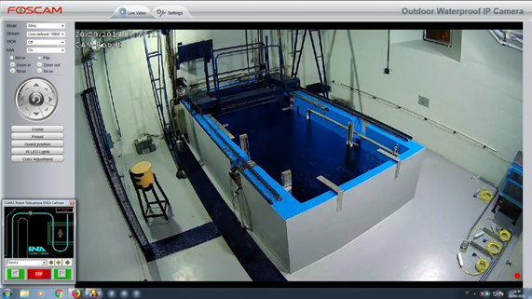
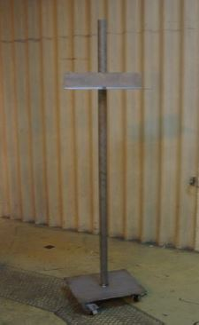
Irradiation tests
Irradiation procedure:
⁶⁰Co source Calliope irradiation facility ENEA Casaccia, Rome;
Four experimental conditions analyzed: 0Gy 0.5Gy, 5Gy (dose rate 6Gy/h), 30Gy (dose rate 60Gy/h);
Irradiation of plants at two different growth stages (30 and 60 days after sowing (DAS).
Aim of the work
The research activity is focused on the effects of components of ionizing radiation on tomato plants (cv. MicroTom) engineered for the constitutive expression of anthocyanins.

Slide 9
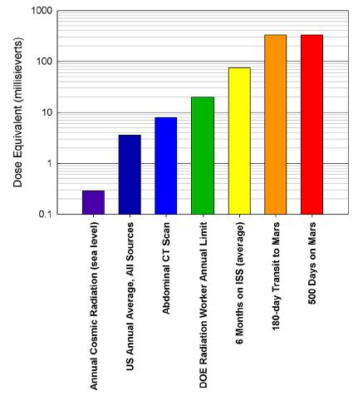
Radiation risk for a human mission to Mars
Irradiation procedure:
⁶⁰Co source Calliope irradiation facility ENEA Casaccia, Rome;
Four experimental conditions analyzed: 0Gy 0.5Gy, 5Gy (dose rate 6Gy/h), 30Gy (dose rate 60Gy/h);
Irradiation of plants at two different growth stages (30 and 60 days after sowing (DAS).
Comparison between the radiation dose equivalent for a 500-day surface stay and a 180-day transit to Mars (22), a 6-month stay on the International Space Station (ISS) at 420 km altitude during the 2013 solar maximum, and several earth-based sources of radiation (Hassler et al., 2014).

Slide 10
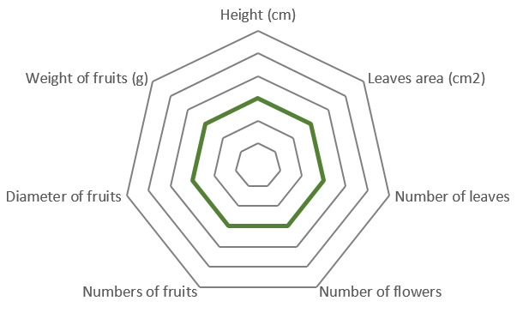
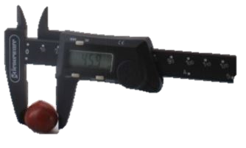
Materials and Methods
Morphometric analysis were performed once a week throughout the crop cycle in order to measure the following parameters (measurements started at day 30 and 60 after sowing (DAS) until fruits maturation (about 100 days):
Plant height (measured using a digital caliper);
Overall leaf area (measured using Image J 1.8.0 (National Institute of Health, USA);
Number of leaves per plant;
Number of flower per plant;
Number of fruits per plant;
Fruit weight at maturation;
Fruit size (determined measuring the fruit equatorial diamater by a digital caliper).
+P<0.0001
+P<0.001
+P<0.05
0
-P<0.05
-P<0.001
-P<0.0001
Results were reported in radar graphs where statistically significant differences between non-treated controls and treated plants lays on radial lines according to the different degree of significance

Slide 11
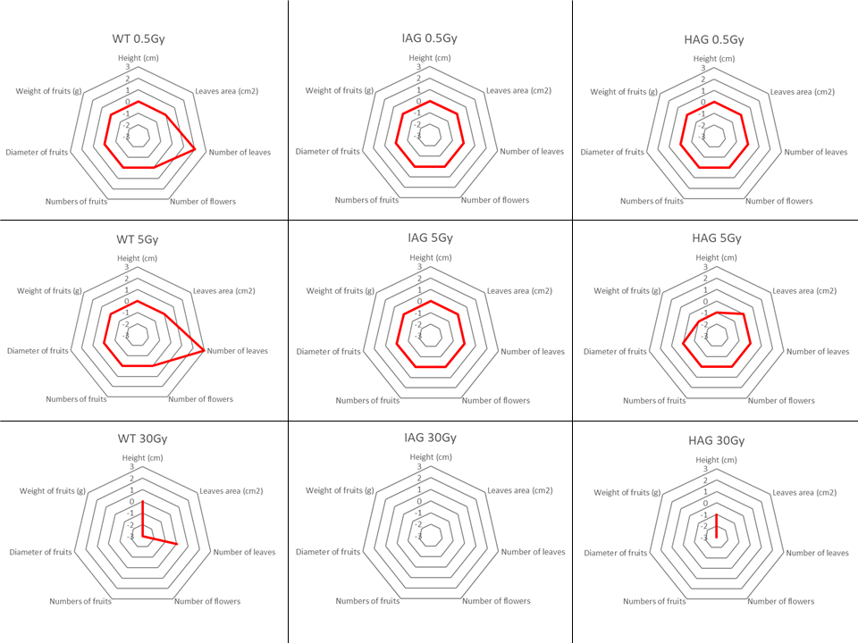
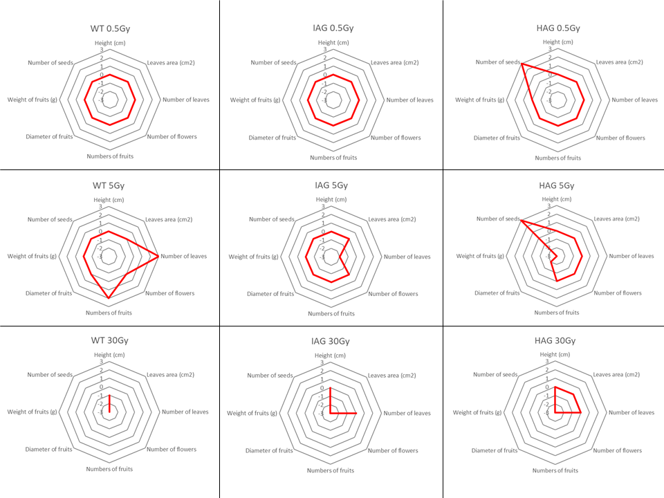
Summary of morphometric results
IAG plants irradiated with low-dose (0.5 and 5Gy) showed the greater stability of the morphometric parameters considered
30 DAS
60 DAS

Slide 12
Conclusions
All plants irradiated with gamma rays completed the whole plant cycle from seed to seed;
IAG plants irradiated with low-dose (0.5 and 5 Gy) showed the greater stability of the parameters considered;
no significant differences (for both two growth stages and genotypes) were detected in plants irradiated with low-dose gamma rays (0.5 Gy) showing that all the three genotypes are substantially equivalent;
irradiation with 5 Gy dose showed a significant increase in the number of fruits only in wild type plants irradiated at 60 DAS;
As expected, irradiation with 30 Gy dose resulted in a drastic reduction of all the paramenters considered for both two growth stages.

Slide 13



If you are interested in ‘agro-space’ research please make sure to visit our website: www.hortspace.enea.it
We have also a lot of other ongoing projects running in the virtual section of the RAD9 Conference:
RAD9-171: Qualification and research activities at ENEA Calliope gamma facility (Casaccia R.C., Rome, Italy);
RAD-182: Characterization and applications of electron and X-ray beams of the Rex Facility;
RAD-183: Irradiation activities for Displacement Damage radiation testing at the TOP-IMPLART proton accelerator;
RAD-257: Ground-based preliminary tests to simulate space microgravity and radiation effects on plants in the seed to seedling transition;
RAD-442: Semiconductor detectors for monitoring radiation processing.
Thanks for your attention!

